Slide 1

Rover Path Navigation via Aerial Imagery
Dyllon Dunton and Sophie Walden
Notes:
D/S

Slide 2
01
Background
Information
Notes:
s

Slide 3

Motivation
the University Rover Challenge from the Mars Society brings robotic teams to make rovers for Mars terrain. This last year's competition saw a new technique: rover path planning using an aerial drone.
What if you could expand this from Mars rovers to all available drone footage, old and new?
Notes:
Sophie

Slide 4
Project Milestones and Success Factors
Video Stitching
01
Stitch together aerial drone footage into a panoramic photo and run ZoeDepth on it
Segmentation
02
Convert the panorama into small chunks for a segmentation model to designate “off-limit obstacle zones”
Path Planning
03
Use the stitched video and segmentation map to perform A* of a projected rovers path
Visualization
04
Rendering all outputs into a fully interactive demo website
Notes:
Sophie

Slide 5
02
Architecture &
Design

Slide 6
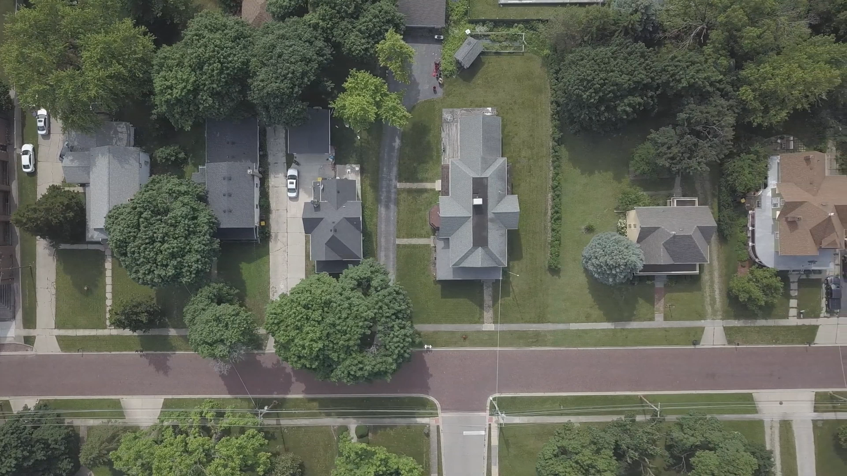
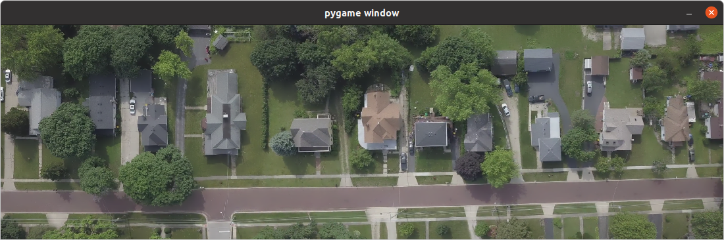
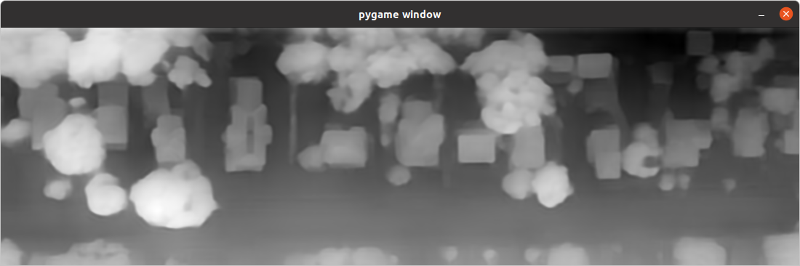
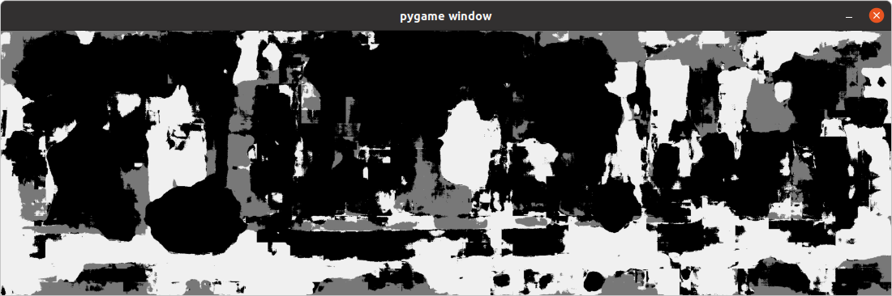
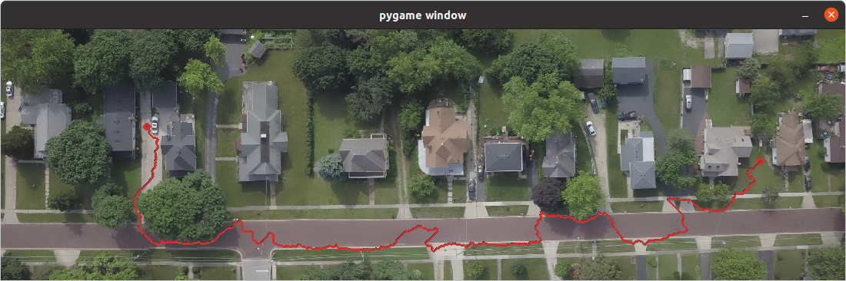
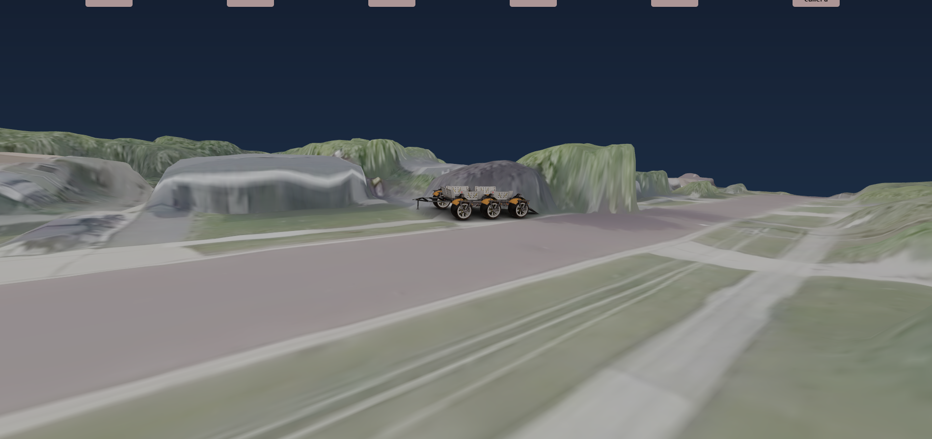
Pipeline
Image Stitching
Depth Model
Segmentation Model
Path Planning & Visualization
Notes:
d

Slide 7
Video Stitching (Photogrammetry)
Use OpenCV
Convert MP4 to frames with cv2.VideoCapture()
Stitch list of frames together using cv2.Stitcher_create() and cv2.Stitcher.stitch(frames)
Finds Matching Features
Outlier Removal with RANSAC
4 Point equation to make Homography
Warp Images to align together
Return new panorama
Notes:
d

Slide 8
Depth Model: ZoeDepth (ML)
Input: Panorama
Output: Depth Map
Used ZoeDepth [3]
Simple git clone and local install
Takes any input size
Notes:
d

Slide 9
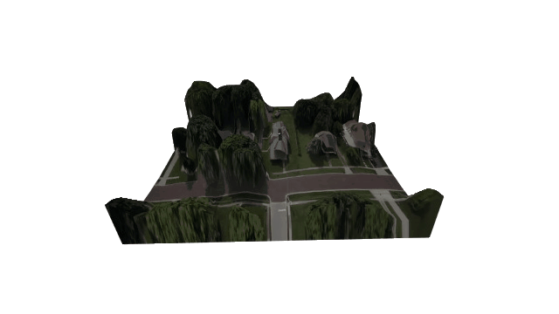
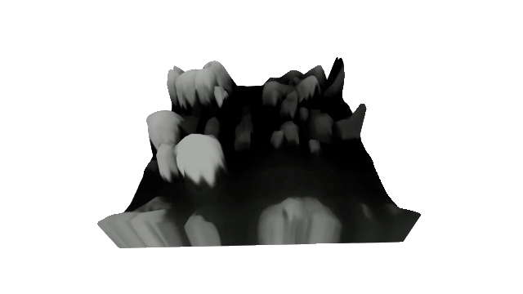

Other Explored Avenues
Video-Based 3D Models
Running ZoeDepth on every frame instead of stitched video
Color-Based Segmentation
Gaussian Filter
Blur
Flood Fill
Constrain to 3 different colors
Notes:
Sophie

Slide 10
Segmentation Model (ML)
Input: Panorama
Output: Drivability Map
Dataset of 400 images with 24 classes
Splice Resnet and a Decoder (U-NET) [2]
Patching and Voting System
Convert to Drivability Map
Notes:
d

Slide 11
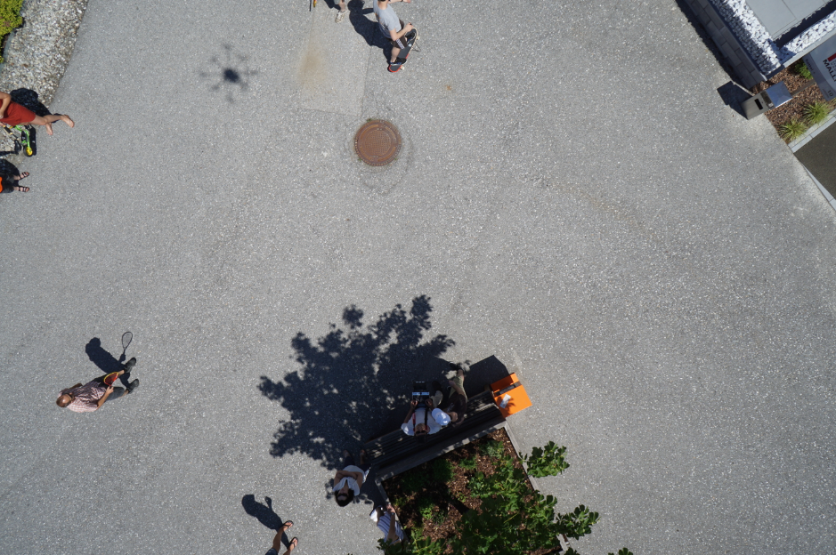
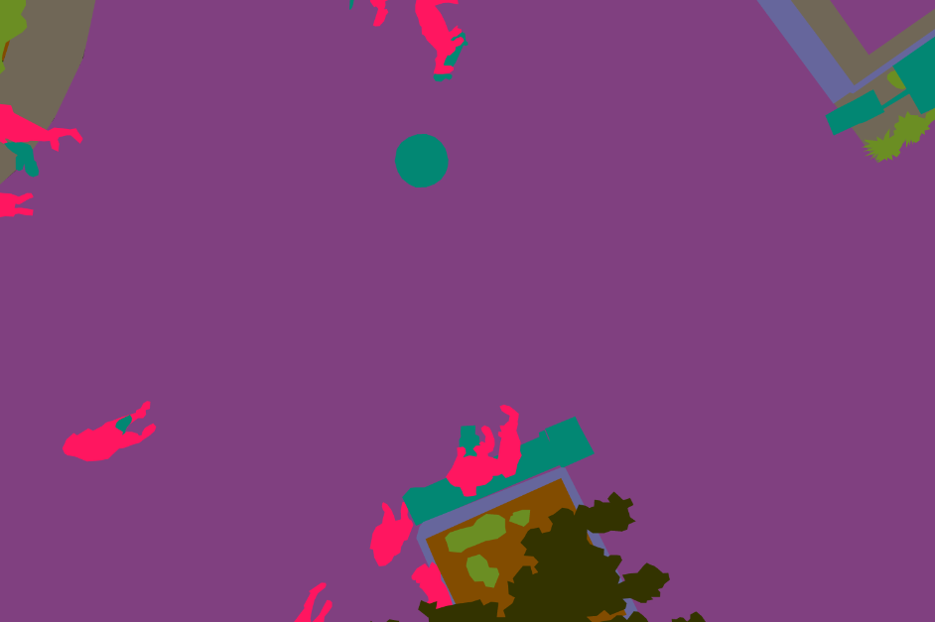
Semantic Drone Dataset
Found on Kaggle [1]
Frequent use
400 images with 4K Res
Split into 9:1 for training and validation
Data augmentation by creating 31 new images for each original (11,160 train, 1,240 validation)
24 classes (pavement, dirt, grass, tree...)
Notes:
d

Slide 12
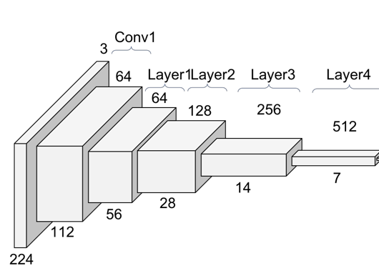
Segmentation model Architecture
Resnet34 Encoder
Custom Decoder
24
32
64
128
256
14
28
56
112
224
Notes:
d

Slide 13
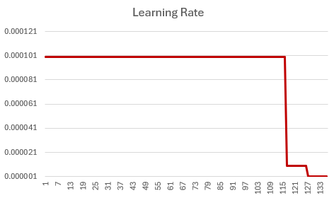
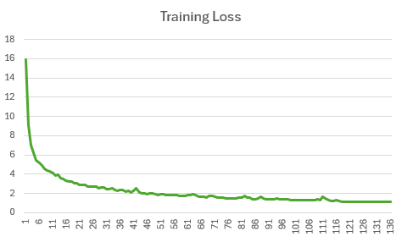
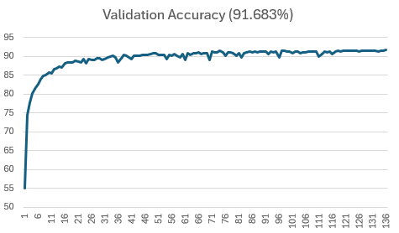
Segmentation Training
1E-4
Using Adam Optimizer in PyTorch
Stored semantic labels as .pt files since 24 channel (int tensors)
Measured Pixel Accuracy each epoch
2 hours of supervised training on NVIDIA A4500 GPU w/ 16GB GPURAM
1E-5
1E-6
Notes:
d

Slide 14
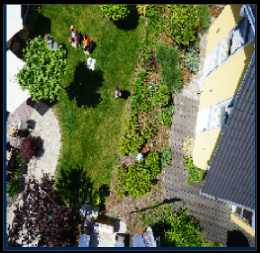
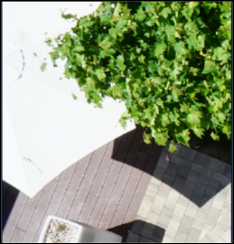
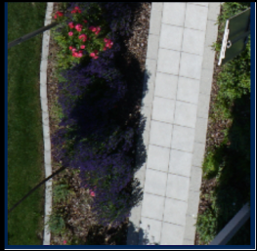
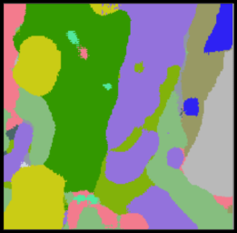
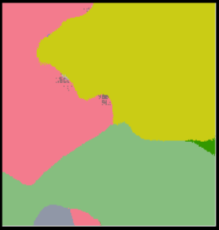
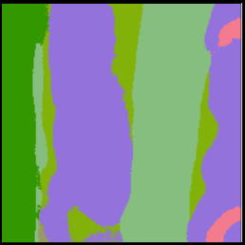
Validation Examples
Notes:
d

Slide 15
Segmentation Implementation
Cannot simply run model on whole image, resolution to low
Create grid of 200x200 squares on panorama
Run model on each patch
Aggregate each patch together
Creates boundary phenomena
Shift grid and rerun (5 total grids)
Have 5 runs with shifted borders vote
Lookup table for ideal (white), drivable (gray), and undrivable (black) classes
Convert to drivability map
Notes:
d

Slide 16
03
Pathfinding & Visualization
Notes:
s

Slide 17
Path Finding
A* Pathfinding
X/Y Coordinates are normal
Z Coordinate is the pixel value of heightmap
Segmentation Map adds a cost multiplier to encourage driving in “optimal conditions”
Pathfinding tool created
Click on two points in the displayed image and generate a JSON of the path
Notes:
Sophie

Slide 18
Demo Website?
What?
Why?
01
02
A digital playground for people to fly around landscapes generated from drone footage
Our models generate a ton of amazing data, but the only visually interesting data is the rovers path. The website helps make the other generated data visually interesting
How?
Where?
03
04
A digital exploratory environment was created using Three.js, a Javascript based 3D Graphics library
Hosted on GH-Pages.
I encourage you to go explore it at bit.ly/cos473
Notes:
s

Slide 19
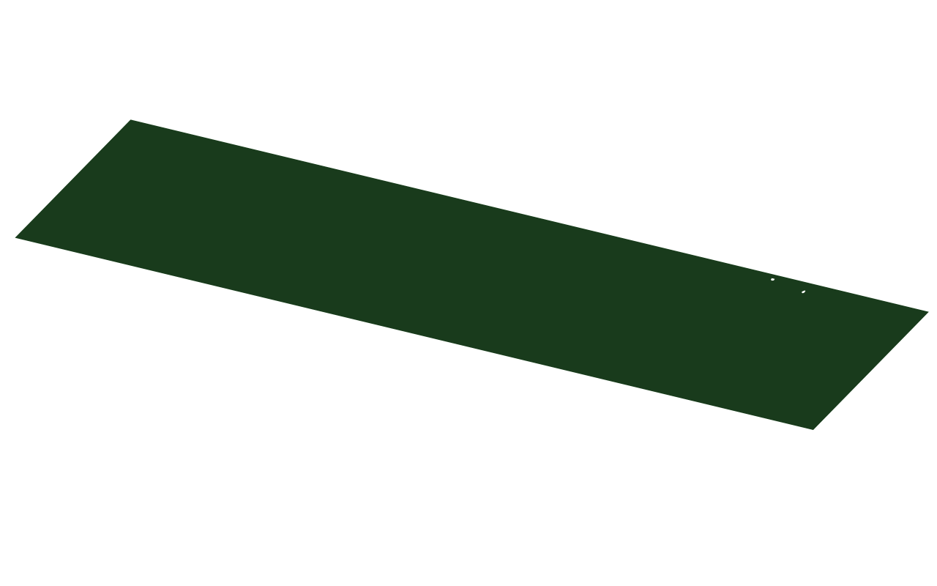
How Does the Site Do That?
Notes:
s

Slide 20
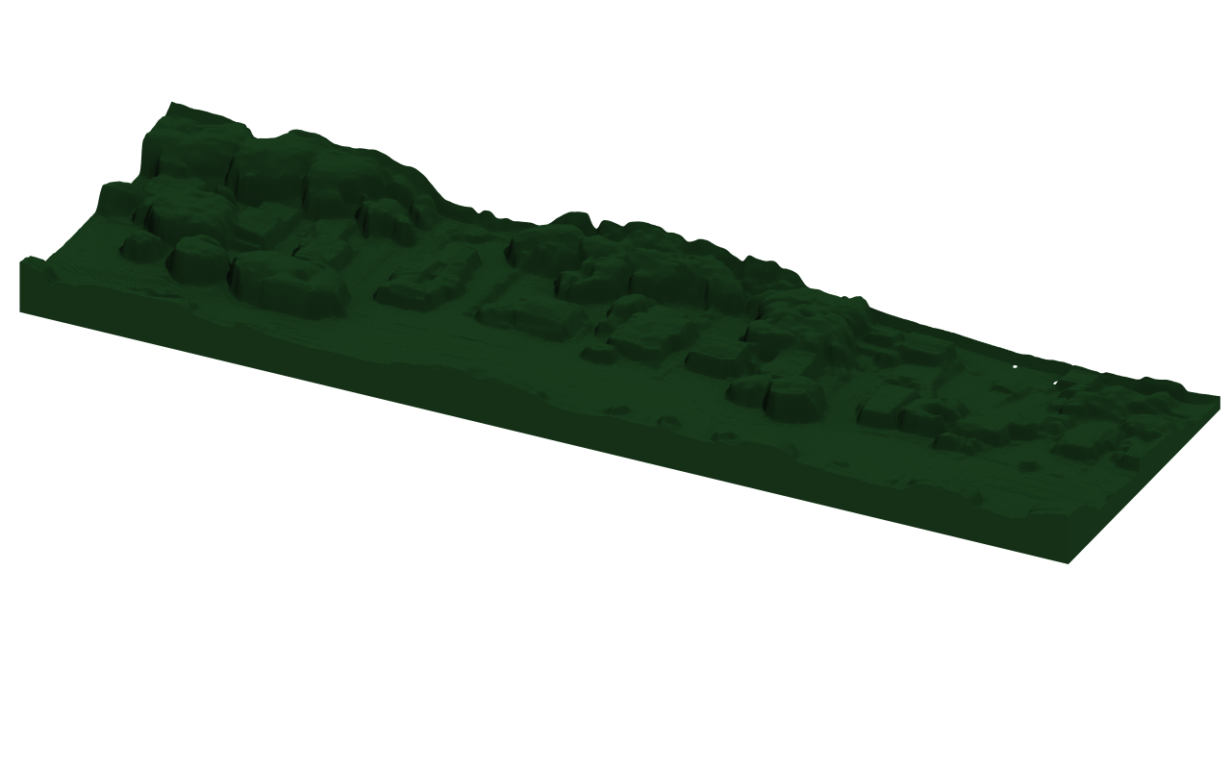
How Does the Site Do That?
Notes:
s

Slide 21
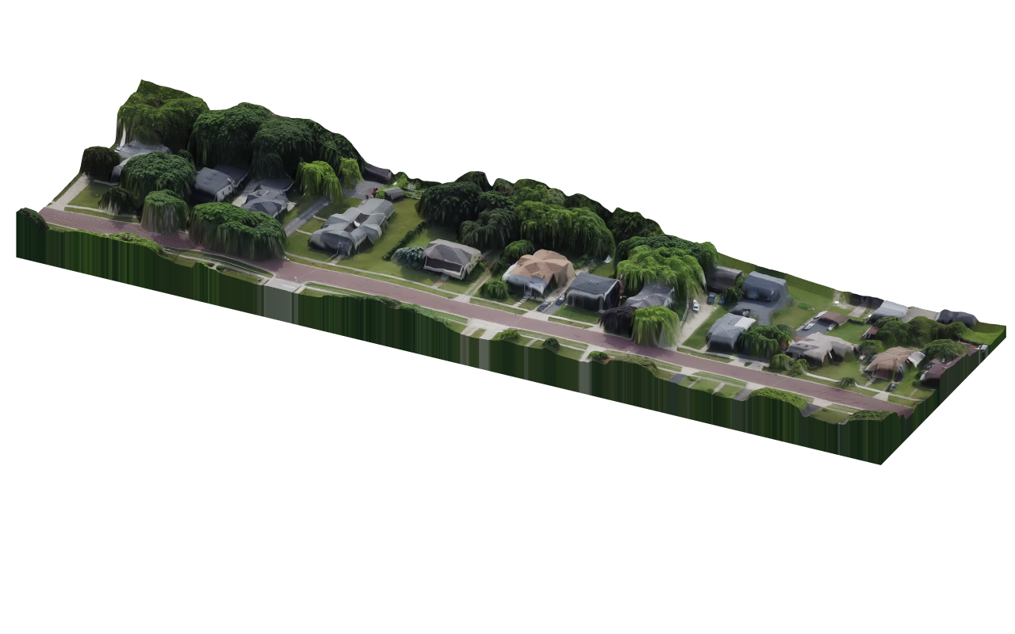
How Does the Site Do That?
Notes:
s

Slide 22
How Does the Site Do That?
Notes:
s

Slide 23
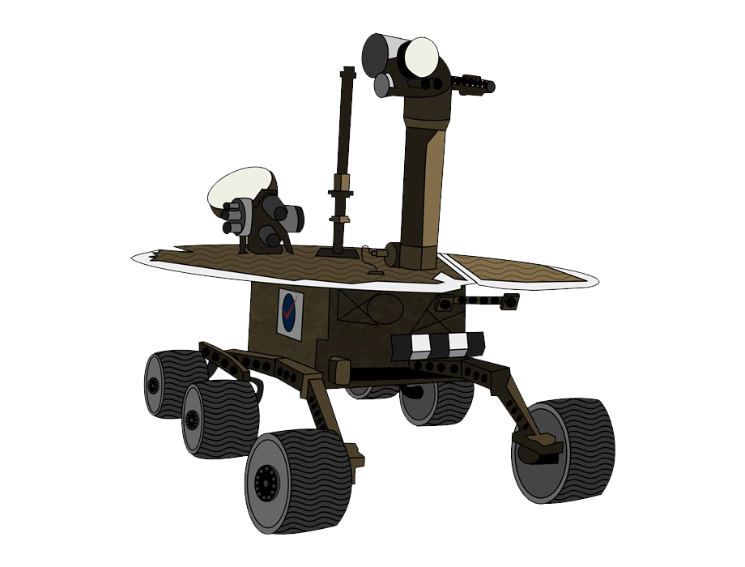
How Does the Site Do That?
Notes:
s

Slide 24
How Does the Site Do That?
Notes:
s

Slide 25
How Does the Site Do That?
Notes:
s

Slide 26
How Does the Site Do That?
Notes:
s

Slide 27
How Does the Site Do That?
Notes:
s

Slide 28
How Does the Site Do That?
Notes:
s

Slide 29
How Does the Site Do That?
Notes:
s

Slide 30
04
Complete Pipeline
Notes:
d

Slide 31
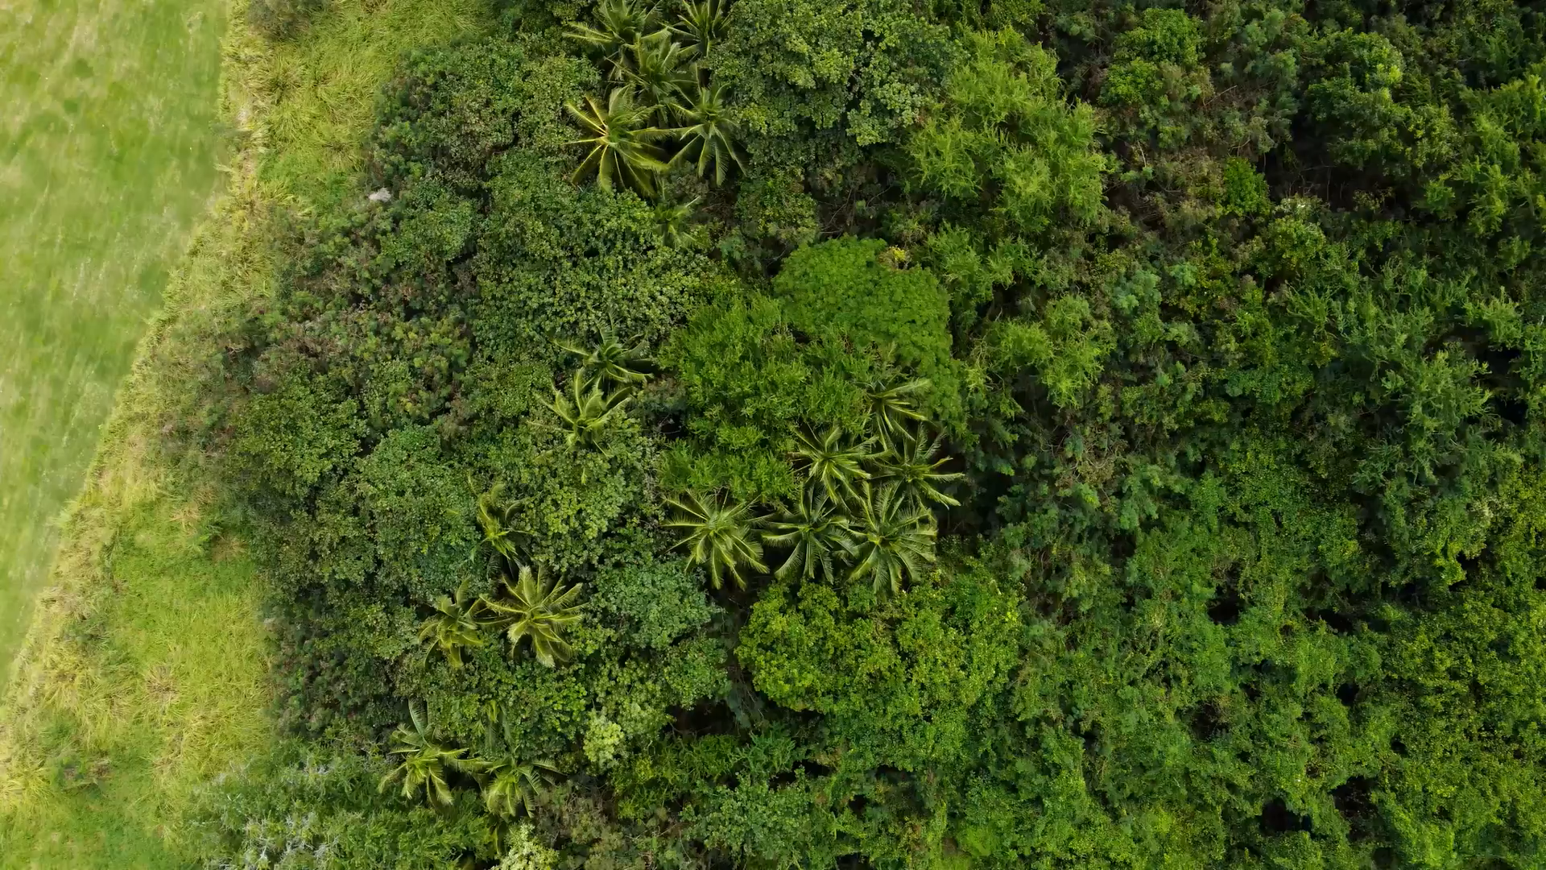
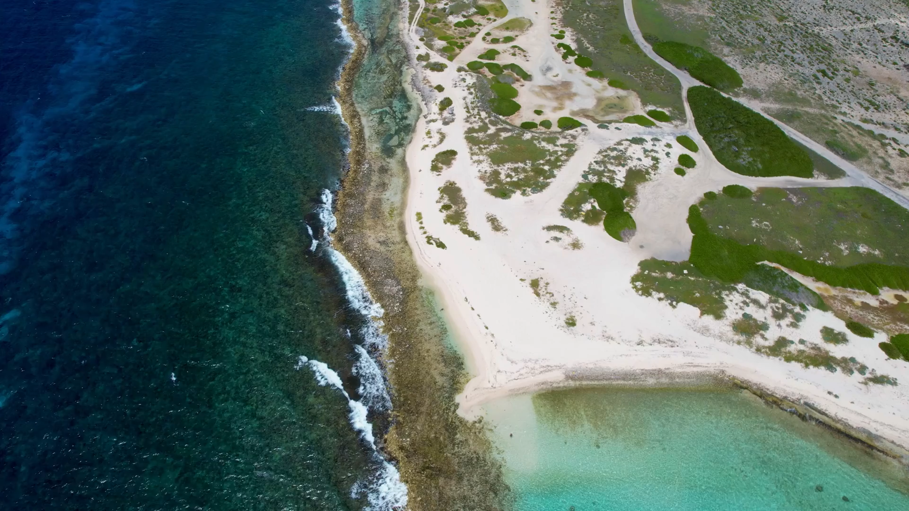
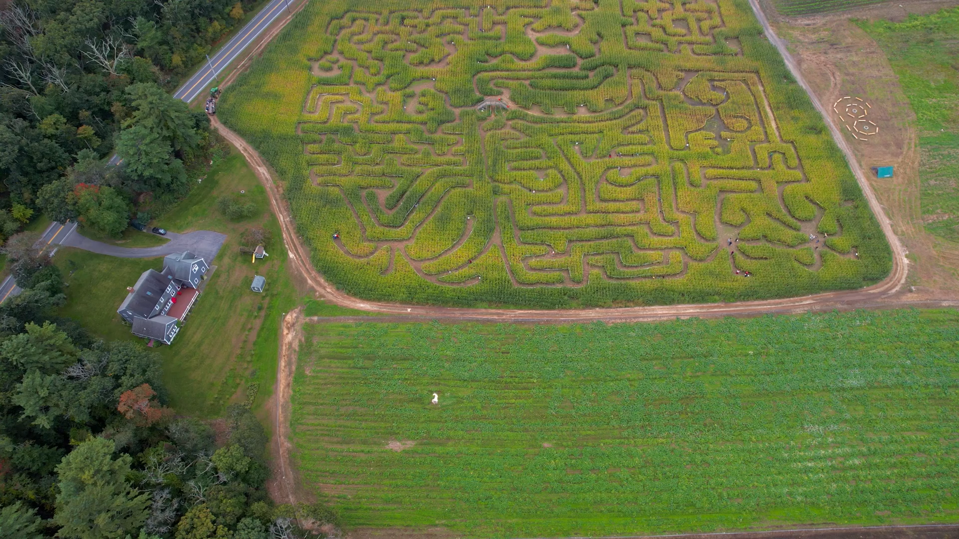
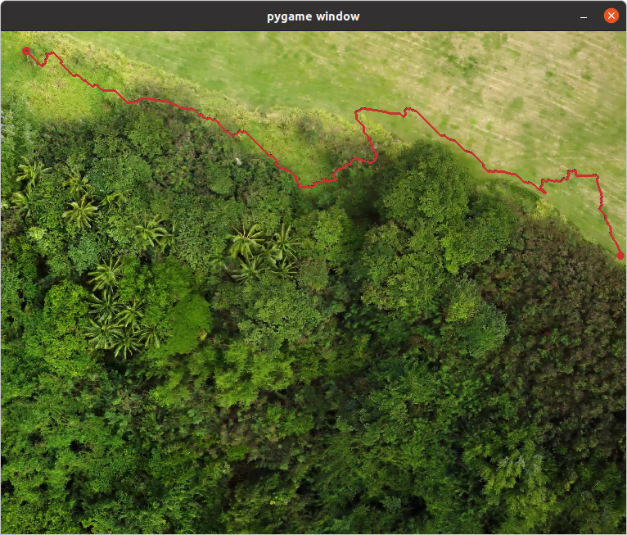
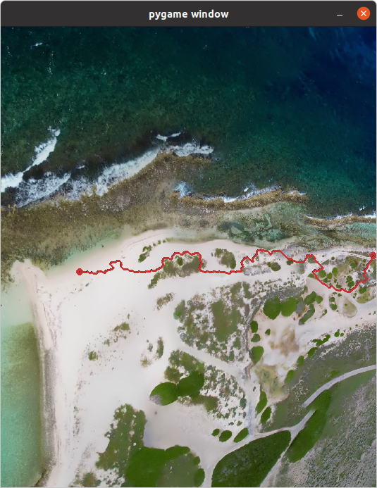
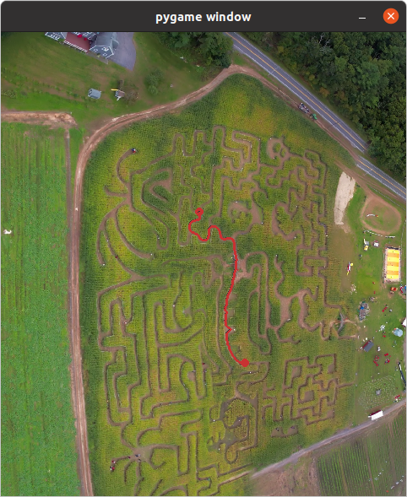
More Results
Notes:
d

Slide 32
Future Work
Hybridized Segmentation
Multiple models with fewer classes
trees, vegetation, grass and other forestry [4]
buildings, walls, roads, bridges and other manmade structures
water, dirt, sand, and other soil types
Helps with generalization and reduces guess conflicts
Use depth map to get gradient map to find areas flat enough to drive on instead of using it as cost to get a more optimal path
Implement method for automatic use of this system
Maybe have the drone fly above rover after mapping and send action signals to rover to help it follow the path?
Maybe create a video from perspective of rover and use ML to have it try to follow the video?
Notes:
d

Slide 33
Conclusion
Milestone 1: Finished by Dyllon Dunton
Video stitching & ZoeDepth
Milestone 2: Completed by Dyllon Dunton
Segmentation model
Milestone 3: Completed by Sophie Walden
Using data to path plan
Milestone 4 Completed by Sophie Walden
Data and Path Visualization
Notes:
s

Slide 34
References
[1] A. W. Saf, "Semantic Drone Dataset", [Online]. Available: https://www.kaggle.com/datasets/awsaf49/semantic-drone-dataset. [Accessed: 24-Nov-2024].
[2] O. Ronneberger, P. Fischer, and T. Brox, "U-Net: Convolutional Networks for Biomedical Image Segmentation," presented at the International Conference on Medical Image Computing and Computer-Assisted Intervention (MICCAI), Munich, Germany, 2015, pp. 234–241. [Online]. Available:https://arxiv.org/abs/1505.04597.
[3] S. F. Bhat, R. Birkl, D. Wofk, P. Wonka, and M. Müller, "ZoeDepth: Zero-shot Transfer by Combining Relative and Metric Depth," Proceedings of the IEEE/CVF Conference on Computer Vision and Pattern Recognition (CVPR), pp. 1-10, 2023.
[4] H. R. Flø Rasmussen, J. H. Rosenlund, and K. D. Madsen, "Forest Inspection Dataset for Aerial Semantic Segmentation and Depth Estimation," arXiv preprint arXiv:2403.06621v1, Mar. 2024. [Online]. Available: https://arxiv.org/abs/2403.06621v1. [Accessed: 24-Nov-2024].
Notes:
s

Slide 35
Source Code
https://github.com/DyllonDunton1/Height_Map_UNET/blob/main/segmentation_trainer/segment.py
https://github.com/SophieWalden/HeightmapVisualization
Notes:
s

